Slide 1

COUCH
to
COMPROMISE
grimm.rip
How to Pwn a Large Enterprise like a Real Malicious Attacker
By Johnny Xmas - linktr.ee/johnnyxmas
Notes:
GET YOUR CAMERAS OUT. These sides are NUTRIENT-RICH

Slide 2


// Security Researcher @ GRIMM
Training Government Agencies in Critical Infrastructure Cyber Defense
Assisting CyPhy and AppSec teams in security assessments and training development
Performing Independent Research and Development to discover vulnerabilities in important technologies
Johnny
Freakin’
Xmas
// Penetration Tester @ Redlegg
Contracted assessment of physical, digital and cultural security postures at companies ranging from SMB to Global 1000
General consultation on Governance, Risk & Compliance, along with all other aspects of information security
// Security Engineer @ Officemax
Engineering of security systems for a Fortune 500 / Global 1000 enterprise
Implemented such security solutions as DLP, Password Management, Web Content Filtering, Proxy, Wireless IDS, and much more
// Founder & Coordinator @ BurbSec
Core staff for Chicago’s most consistently-attended Information Security meetups
Founder of BurbSec East, the second-largest of the groups
// Public Persona & Infosec Diva @ *
Given over 100 presentations in 6 countries on the topics of Technology, Information Security, Privacy and Career Advancement
Makes angry, satirical comments on twitter (@j0hnnyxm4s)
Referenced & interviewed in nearly every major technology media outlet
The TSA Keys Guy
Notes:
Skip through the jobs, get to 2nd list

Slide 3


.rip
Technical Director of Training
SMFS, Inc. d/b/a/ GRIMM
JohnnyXmas@grimm-co.com
Couch to Compromise: How to Pwn an Enterprise in 2023 - Johnny Xmas
@J0hnnyXm4s - johnny at johnny xmas dot net
PREVIOUS PROFESSIONAL ROLES:
Network Engineer
Systems Engineer
Information Security Engineer
Information Security Consultant
Penetration Tester
OT Researcher
Blade Runner (Bot Killer)
LINKS:
https://grimm.rip
https://github.com/johnnyxmas
https://linktr.ee/johnnyxmas
@J0hnnyXm4s
Notes:
Seen on Fox, NBC, Wired, TechCrunch, The Hill, Boing Boing, dozens of minor outlets, and speaking around the world. Just Duck Duck Go me.

Slide 4
Why.
Am.
I.
Here?
Being a Pentester is BORING.
Notes:
(Discuss being a pen tester) My job was to rob banks and trains, and it was BORING
Magicians code
The steps I list here are not effective against all environments.
Unfortunately, they were affective against a huge portion of the environments we came across.
In fact, the bigger they are, the more susceptible they seemed to be.
We’re not going to have time today to discuss every possible attack scenario, or even all common ones. Also keep in mind that even though this entire chain won’t work against you there’s a great chance many steps here WILL.
No time to discuss every possible defense scenario. I will skim over them, you can take screenshots of the deck
This is a 2-hour presentation I am doing at double-speed. STRAP IN.

Slide 5

How
Does
A
Defender
Fix
This?
Learn how the attackers operate, and develop “defense-in-depth,” starting with this low-hanging fruit
Notes:
The big theme you’re going to notice here is “just do this to yourself and generate your own defenses and IoCs based on what’s best for your environment”

Slide 6
Intelligence Gathering
Post-Exploitation
PENETRATION
TESTING
EXECUTION
STANDARD
http://www.pentest-standard.org/
Exploitation
c
Notes:
*HIGHLIGHT MOVES
Explain PTES briefly. Created by Nick Percoco, Chris Nickerson, Dave Kennedy & others
LATER: discuss how we don’t just exploit vulns
This is generally how all attackers will operate, and the pattern of activity you as a defender should be looking for\

Slide 7
FIRST & FOREMOST
// Intelligent ATTACKERS
LIVE OFF THE LAND
Notes:
Attackers rarely exploit known vulnerabilities (because most suck), or even burn 0Days. They exploit lazy / overworked sysadmins.
“Importing” hacking tools is often a PITA, and not necessary when the OS provides everything needed. Even when we do have to use such tools, we try to do so THROUGH a backdoor we run on the exploited system as a proxy, not directly on the system
Malware is only used as a last resort
We live off the land because Defensive Blinky boxes don’t work against “legitimate” activities like successful logins, null sessions, and access that doesn’t require elevated privileges. This is what we’re going to focus on today.

Slide 8
RECON
Notes:
Passively see what’s out there using publicly-accessible sources and taking tons of notes

Slide 9
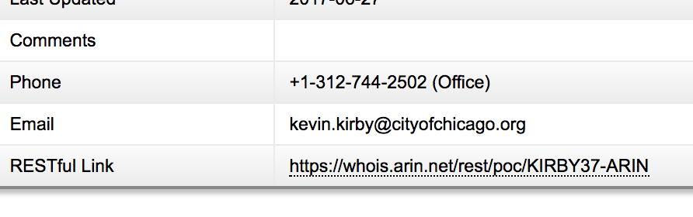
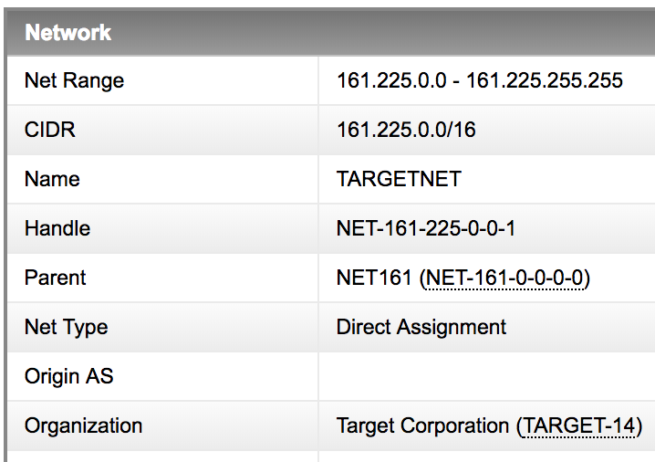
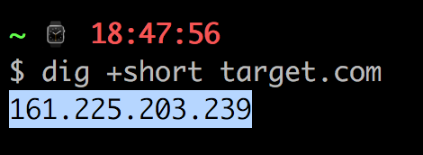
RE
CON NAIS
SANCE
ARIN.NET
Notes:
Where do they live on the Internet?
What are their contacts email addresses?

Slide 10
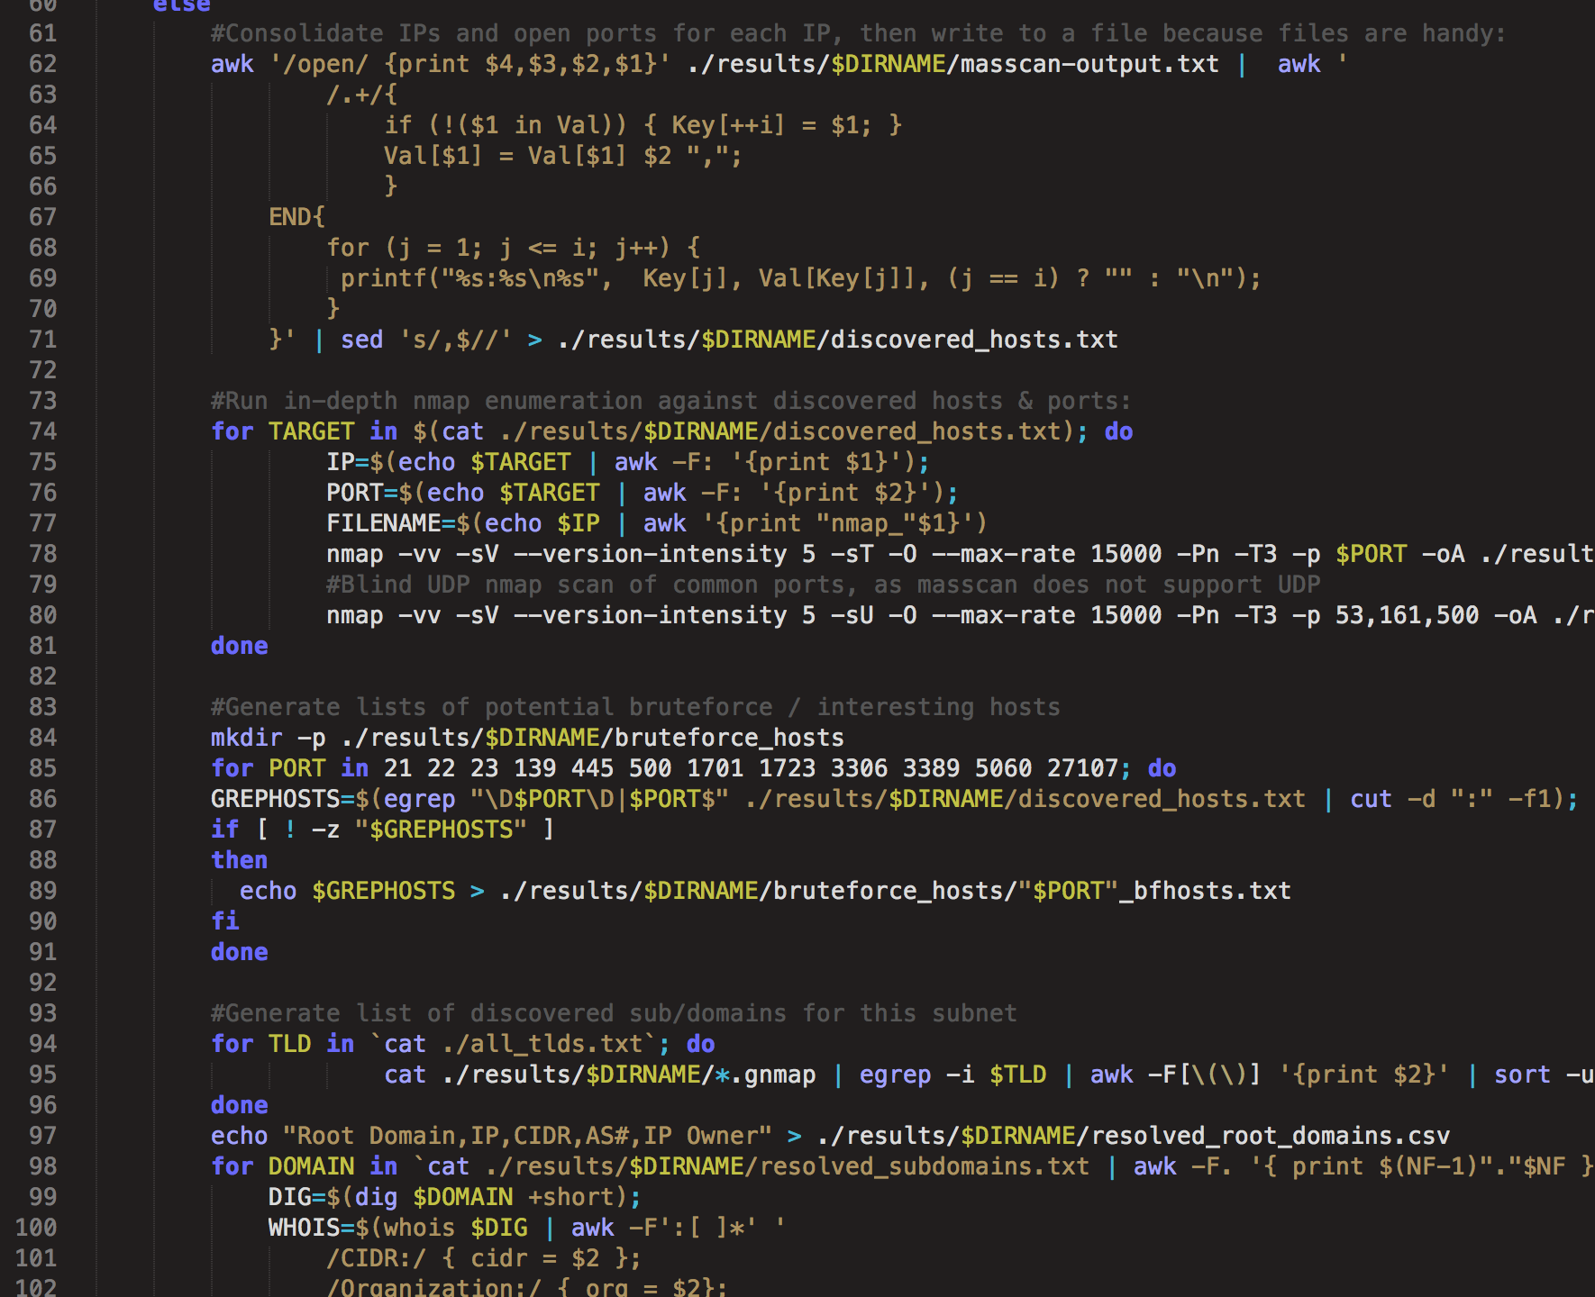
RE
CON NAIS
SANCE
SCANCANNON
Notes:
We’re primarily looking for unprotected logins, specifically those which either auth to the company AD, or have a high chance of password reuse. (AD on next slide)

Slide 11
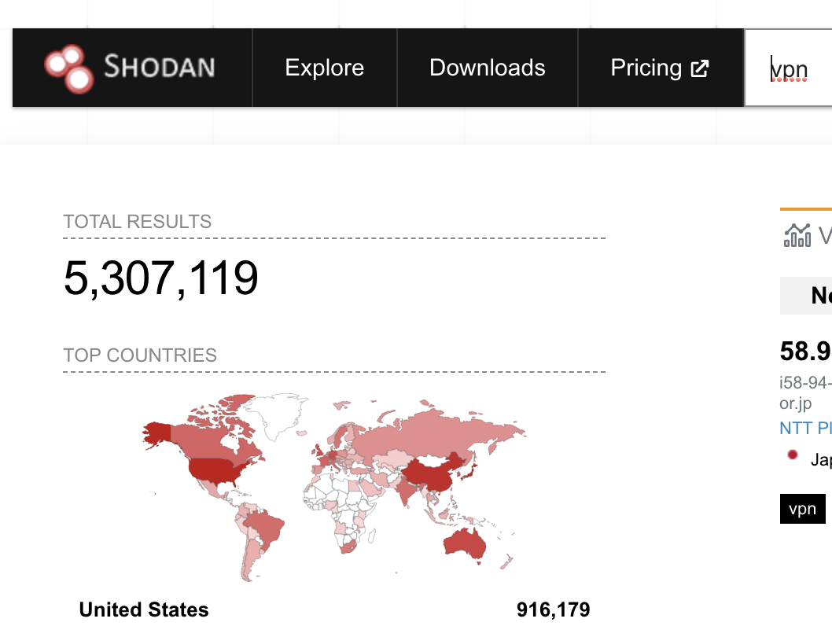
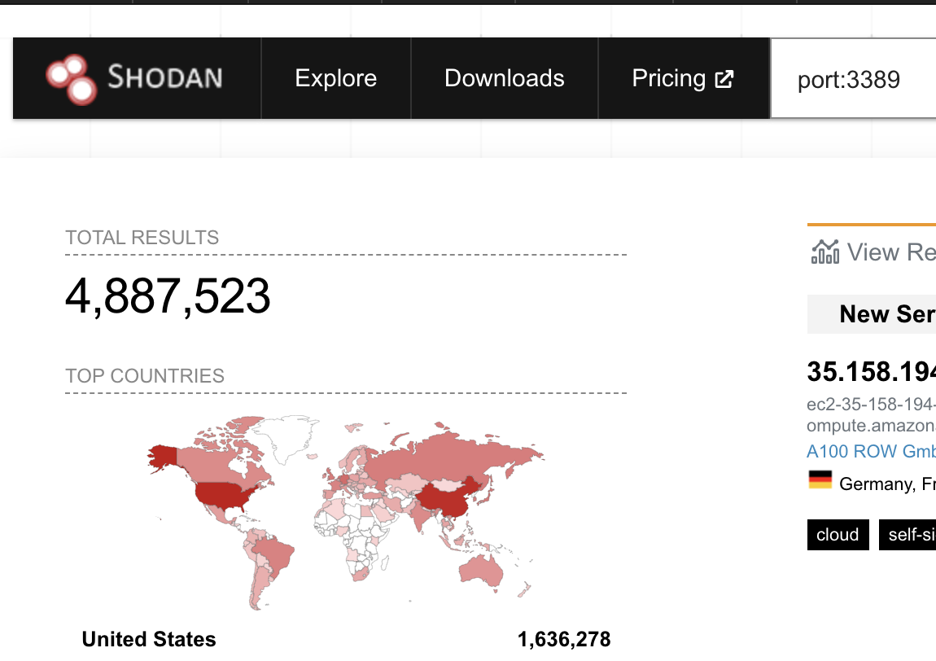
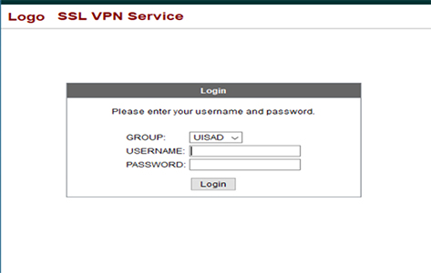
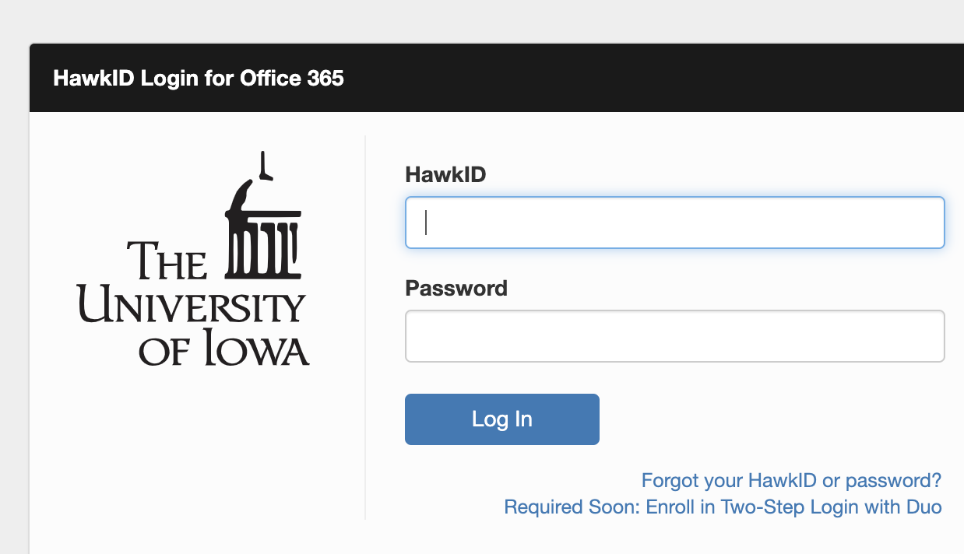
RE
CON NAIS
SANCE
AD LOGINS
Notes:
5.3M VPN OWA
4.8M RDP (when I first did this in 2017 it was 1.7M)
Cool, we can log into shit. But like, with what? (Credentials)

Slide 12
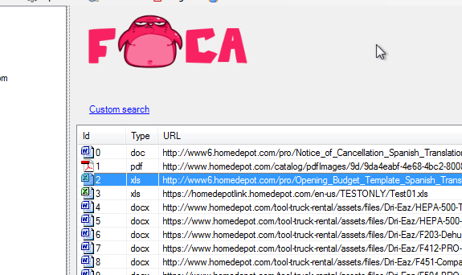
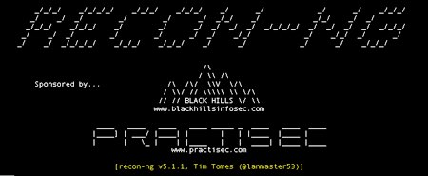
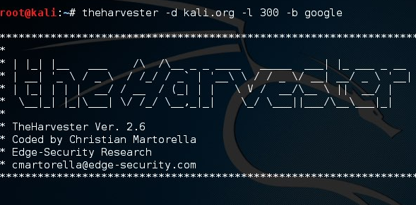
RE
CON NAIS
SANCE
DOX
Notes:
Some documents are obviously useful, for example I’ve seen companies publicly host VPN connection instructions since folks can’t get the instructions if they’re not already on the VPN
But mostly you’re going to find documents that on the surface appear innocuous. However, the metadata can prove super useful. It often contains usernames, email addresses, machine names and sometimes even IP addresses that can be leveraged later when we’re attempting infiltration and lateral movement

Slide 13
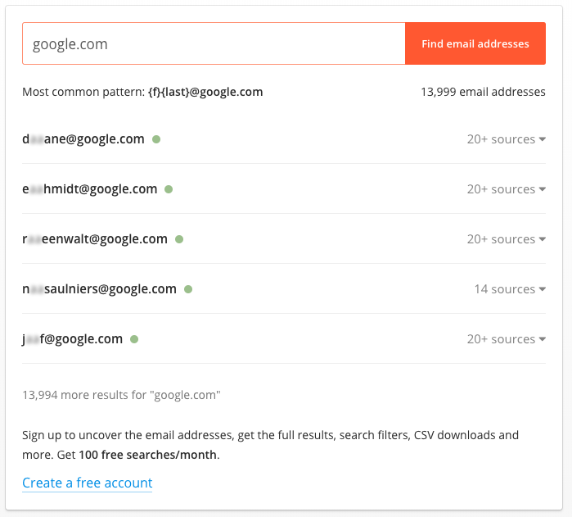
RE
CON NAIS
SANCE
HUNTER.IO
Notes:
Also data.com
This also gives us the email format we can use for phishing, logging in if all we have is names or usernames gathered earlier.

Slide 14
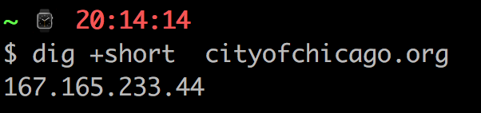
RE
CON NAIS
SANCE
ARIN.NET
Notes:
Don’t forget about rAin being a great source of info on which members of the company likely have elevated access .
Also again email format

Slide 15
RECON DEFENSE
// Port \ Service Scans
IDS\IPS & Other Edge Monitoring
Find it first!
Know your assets!
Google \ Shodan \ FOCA yourself
Write alerts for what you can’t clean
// Private Data Gone Public
Find it first!
Recon-NG Yourself!
Pastebin alerts!
Have Legal Issue Takedowns
Defense in Depth

Slide 16
c
EXPLOITATION
Notes:
PASSWORD PSYCHIC
Notice how we never ran a vulnerability scan
OK, so we have our target AD logins, we have our usernames, but wait, aren’t we missing something else we need to log in? (Passwords)

Slide 17
COMM
MMON
PASS
WORDS
Crap
More Crap
Other Crap
Spring2023
Summer2023
Fall2023
Spring23
Summer23
Fall23
Spring23!
Summer23!
Fall23!
Password
Password1
Password!
Password1!
Password2023
Password23
Password23!
F**k{companyname}
{CompanyActivity} (CEWL)
+(20)23+!
Notes:
Doesn’t matter; we have these:
Wordlists
Sortof overlaps with recon:
Discuss Cewl.
HaveIbeenpwned

Slide 18
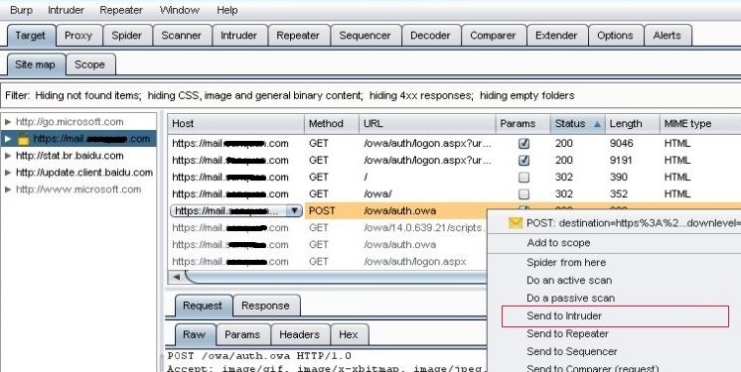
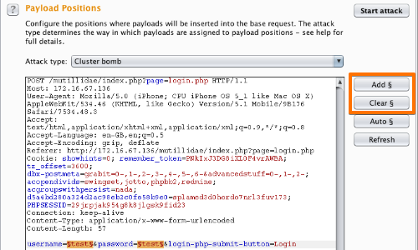
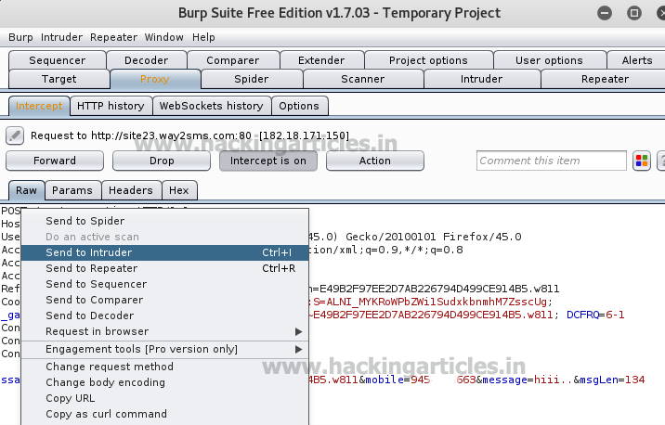
EX
PLOI
TA
TION
BURPSUITE
Notes:
Community version no longer does this!! It’s also usually extremely easy to write a python script that will.
Discuss also being able to suss out account lockout policies once a single hit has been obtained (increases bruteforcing accuracy )
Also mention, Hydra for RDP, ike-force for VPN, Metasploit for everything (incl. domain discovery via ntlm)

Slide 19
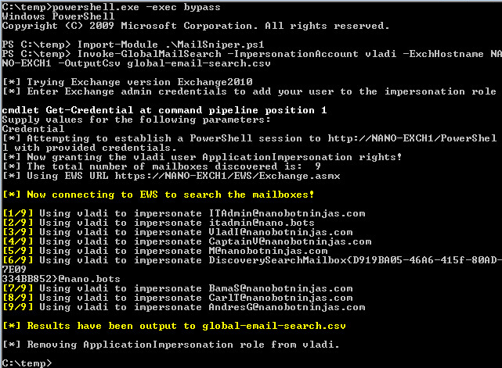
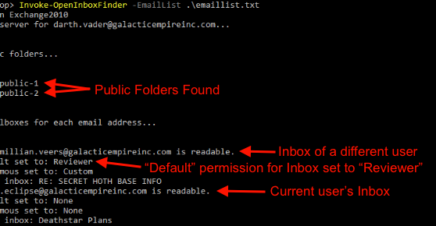
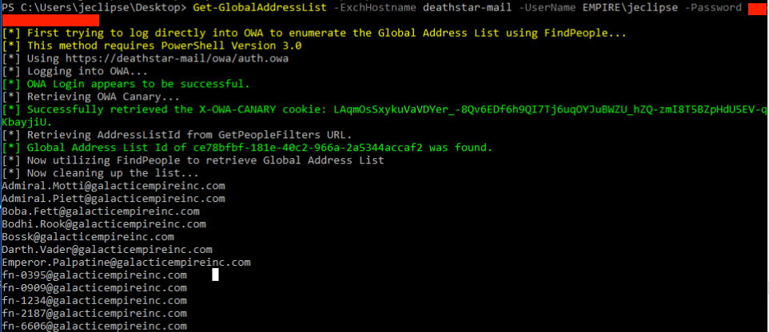
EX
PLOI
TA
TION
MAILSNIPER
O365 Workaround! https://illusive.com/blog/threat-research-blog/mailsniper-you-can-teach-an-old-dog-new-tricks-pwn-o365-based-organizations-by-leveraging-prt-based-sso/
Notes:
Attacks EWS, something most companies aren’t acutely aware they’re running. Many email clients require EWS to sync mailboxes.
Allows you to use email addresses if you don’t know usernames
Lets you scrape mailboxes for terms once you’re in - works on shared mailboxes too
BYPASSES 2FA!!!!!!!!
Works on O365

Slide 20

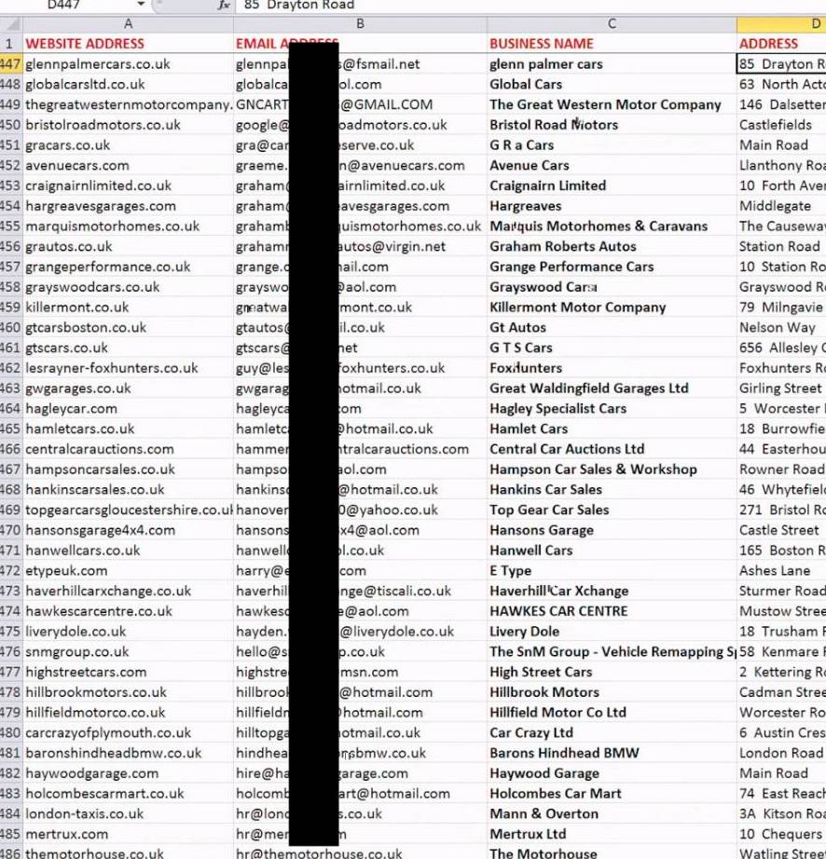
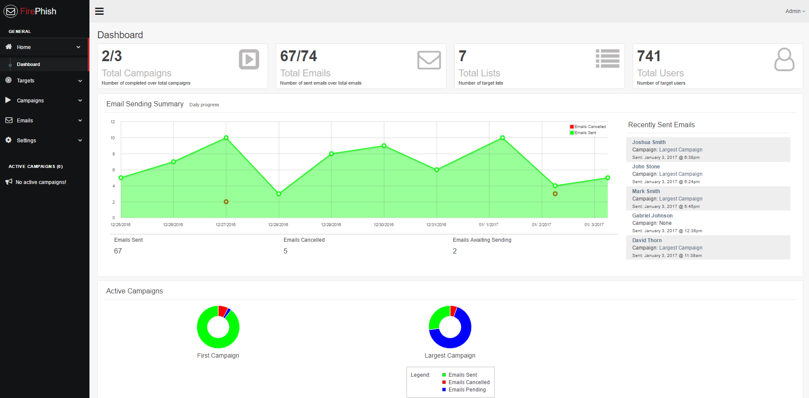
EX
PLOI
TA
TION
FIERCEPHISH
Notes:
cheating.
Talk about why users fall for this in defense.
We also HEAVILY target help desk / IT support because they often have the least experience combined with the most power

Slide 21
CVE-2022-26352
CVE-2022-24706
CVE-2022-24112
CVE-2022-22963
CVE-2022-2294
CVE-2023-39226
CVE-2020-36193
CVE-2020-28949
EX
PLOI
TATION
TOP 10 VULNS
Notes:
All of THAT aside, keep an eye on CISA’s running list of Top 10 exploited vulns for 2022. These are heavily exploited because their effects are often extremely useful.

Slide 22
CVE-2017-11882
CVE-2017-0199
CVE-2017-5638
CVE-2012-0158
CVE-2019-0604
CVE-2017-0143
CVE-2018-4878
CVE-2017-8759
CVE-2015-1641
CVE-2018-7600
EX
PLOI
TATION
OTHER VULNS
Notes:
All of THAT aside, keep an eye on CISA’s running list of Top 10 exploited vulns for 2023. These are heavily exploited because their effects are often extremely useful.
NOTICE THE YEARS.

Slide 23
EXPLOIT DEFENSE
// Phishing
GOOD Awareness training
Phish Yourself
Make users take ownership
Offer pos. and neg. reinforcement
Does HR enforce your AUP?
// Bruteforcing / Guessing
MFA Solution
Lockdown EWS queries
Alert / throttle on anomalous traffic volumes
Notes:
( 1/2 )
Phishing does’t work because your users are stupid, it works because they don’t give a shit.
Stop giving Help Desk keys to the kingdom. They need granular controls.
Lets talk about how to better prevent phishing from working
Discuss Ben’s ant trap issue

Slide 24
EXPLOIT DEFENSE
// Password Bias \ Reuse
Awareness training!
Use whole sentences
No dictionary words in short PWs
No patterns!
No U=P !
> 14 characters+
ENFORCE THIS.
AUDIT YOUR HASHES
Check for dupes
MFA
Stop using passwords
Notes:
The Word(space)number awareness issue. YOU ARE NOT CUTE.
STOP USING DEFAULT RESET PASSWORDS
FORCE CHANGE PASSWORD ON NEXT LOGIN AFTER RESET
MAKE SURE THE USER LOGGED IN BEFORE DISCONNECTING

Slide 25
POST
EXPLOITATION

Slide 26
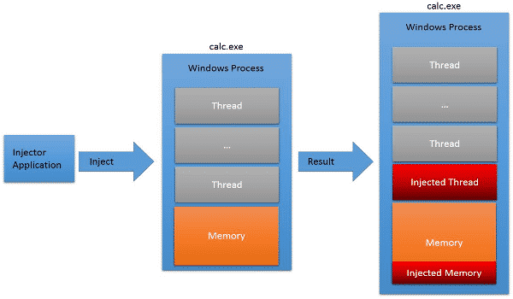
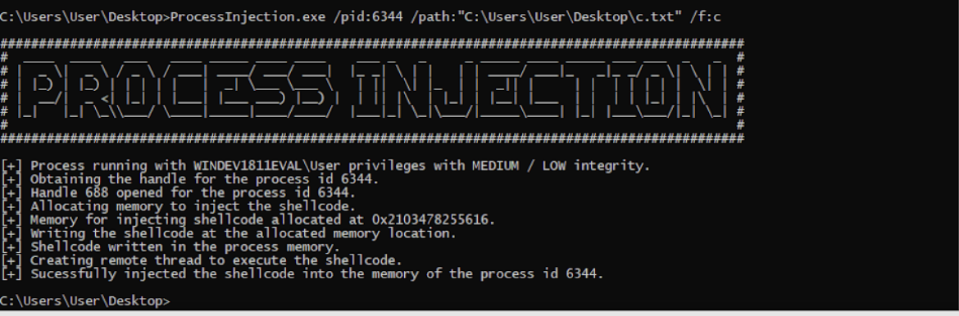
POST
EX
PLOI
TATION
EDR PROCESS INJECTION
Notes:
EDRs are unfortunately easy to bypass in many, if not most situations. We don’t have time to dive into this, but process injection is a great way to either sneak past the EDR, or you can use the much more fun route of injecting your code directly into the EDR process itself.
If you have or are able to get Admin privy on a box you can often simply shut the EDR down either manually or with the proper API call

Slide 27
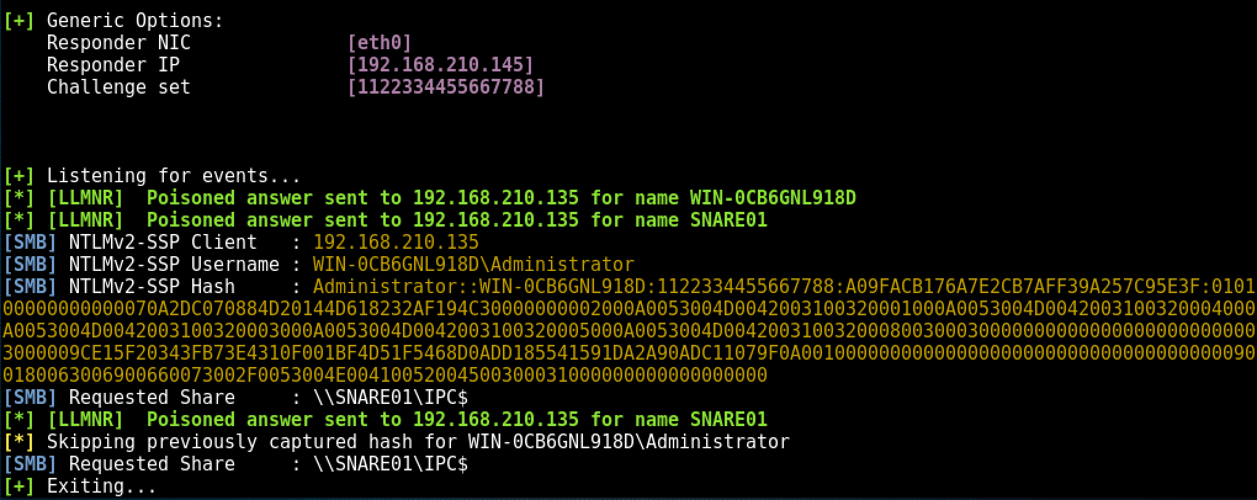
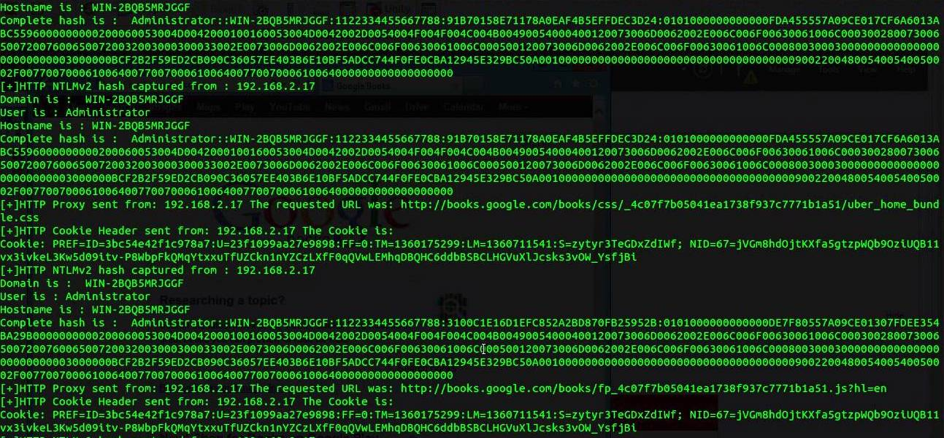
POST
EX
PLOI
TATION
RESPONDER
Notes:
Fire this up while doing other stuff.
Discuss MITM. Allows you to spoof being various shares or servers client machines are actively broadcasting requests for
These hashes cant be passed
Discuss how password cracking doesn’t necessarily require some massive rig.
Cracking onsite with MBP. Password bias / good rulesets because again users’ passwords suck

Slide 28
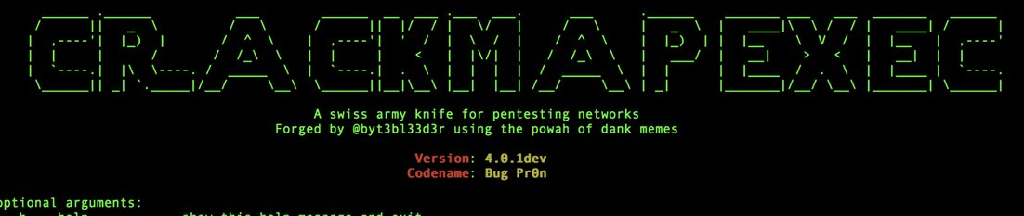
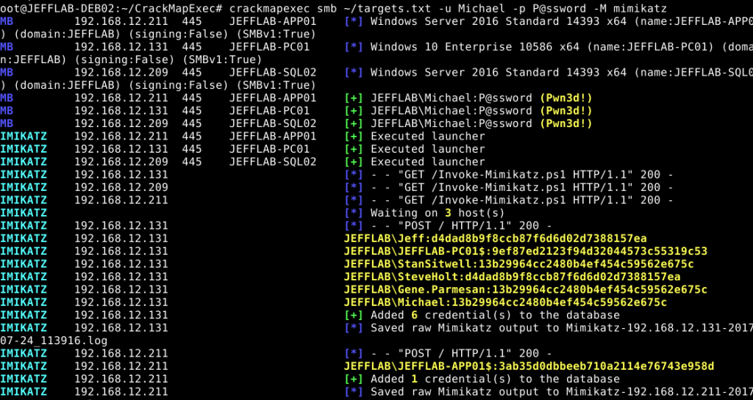
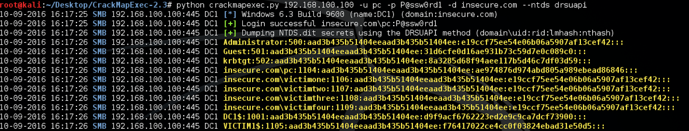
POST
EX
PLOI
TATION
CRACKMAPEXEC
Notes:
CME is an ever-expanding toolkit that finds open shares & Null-Session stuff (gets super dangerous w spraying creds - can even retrieve password hashes & sometimes plaintext passwords
^These are the passable NTLM hashes!

Slide 29
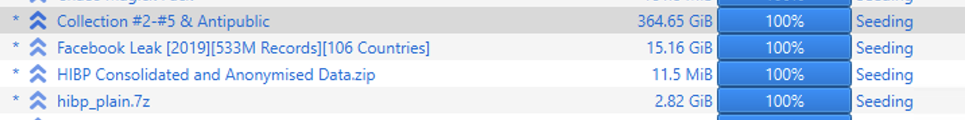
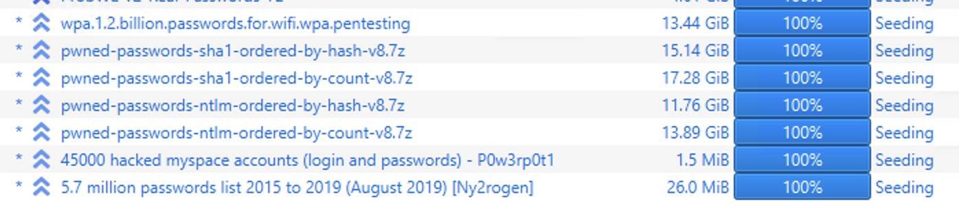
POST
EX
PLOI
TATION
PW CRACKING
Notes:
CME is an ever-expanding toolkit that finds open shares & Null-Session stuff (gets super dangerous w spraying creds - can even retrieve password hashes & sometimes plaintext passwords
^These are the passable NTLM hashes!

Slide 30
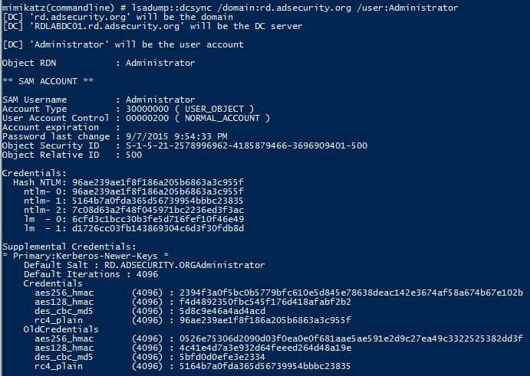
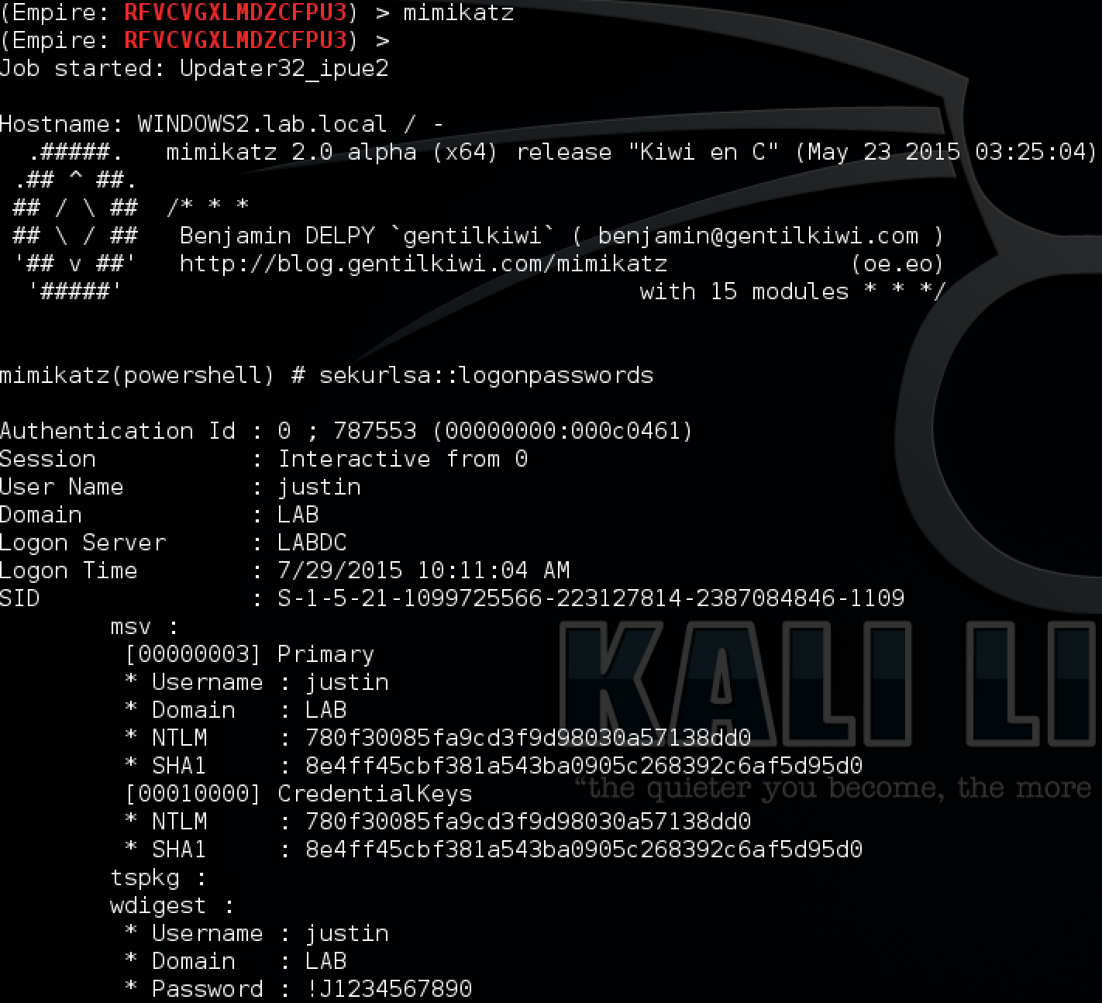
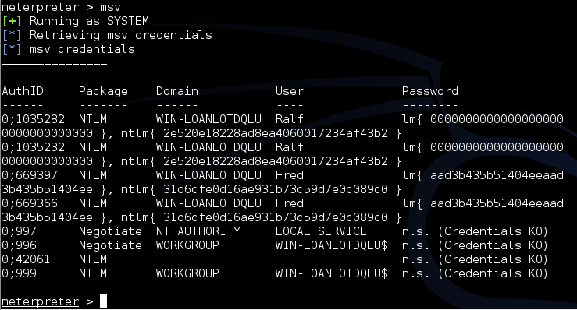
POST
EX
PLOI
TATION
MIMIKATZ
Notes:
First thing an attacker does once local admin is gained is dump lsass, run it through mimikatz offline, and get the passwords.
Feed this back into CME, keep hopping.
Segway: How can we minimize hopping / make it more efficient?

Slide 31
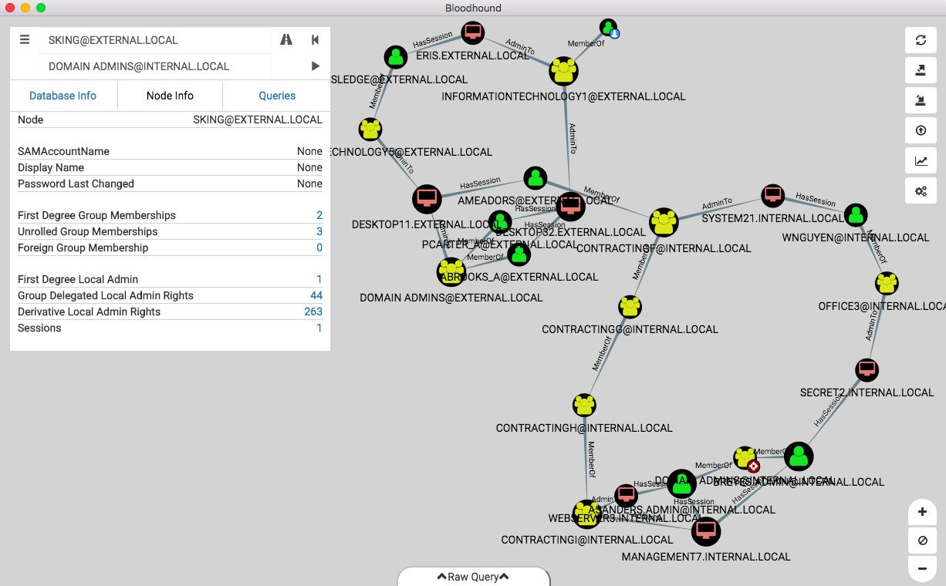

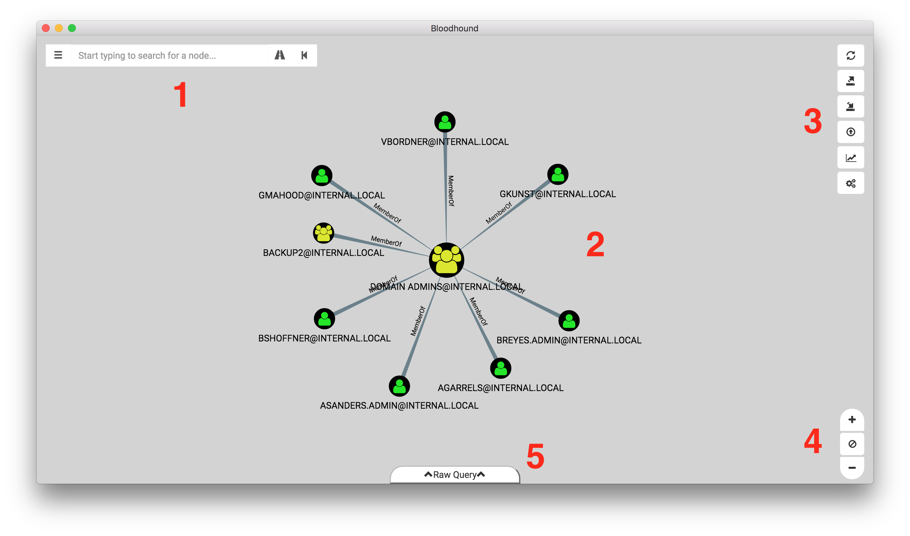
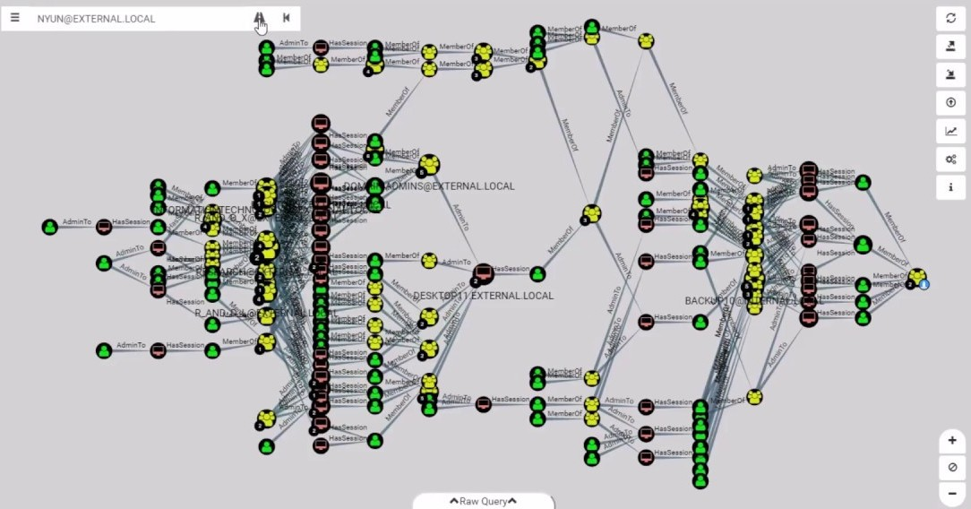
POST
EX
PLOI
TATION
BLOODHOUND
Notes:
We do this to see who is logged in where and with what privileges.
Why? We can source credentials AND SESSION TOKENS #4 is YOINK
(Feed these back into CME)

Slide 32
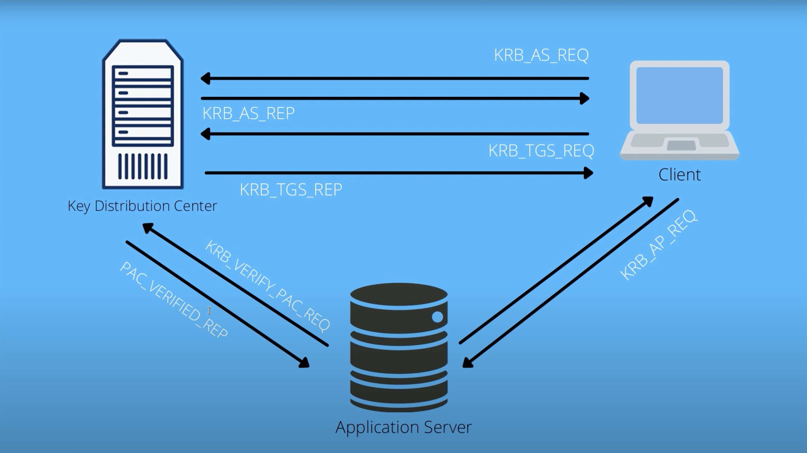
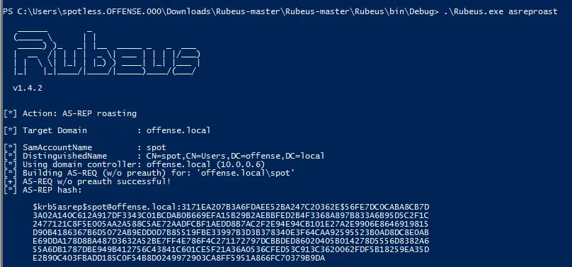
POST
EX
PLOI
TATION
KERBEROASTING
Notes:
And also AS-REP roasting

Slide 33
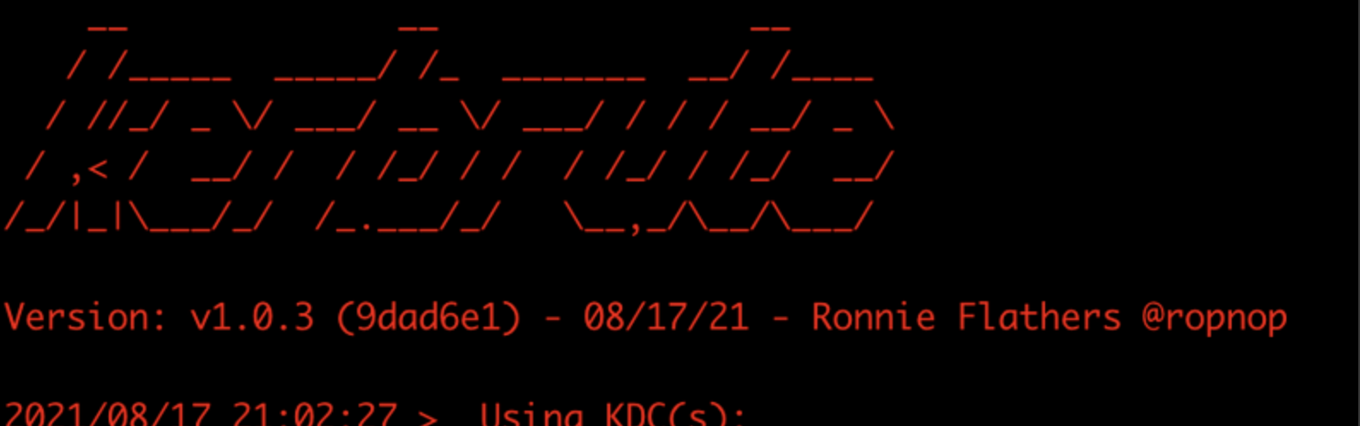
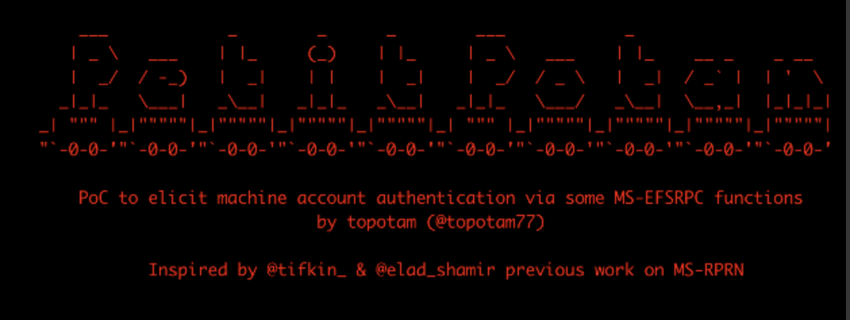
POST
EX
PLOI
TATION
CPO ADCS + PETIT POTAM
Notes:
Certified Pre-Owned Devastating attack that exploits extremely common poorly-configured certificate services

Slide 34
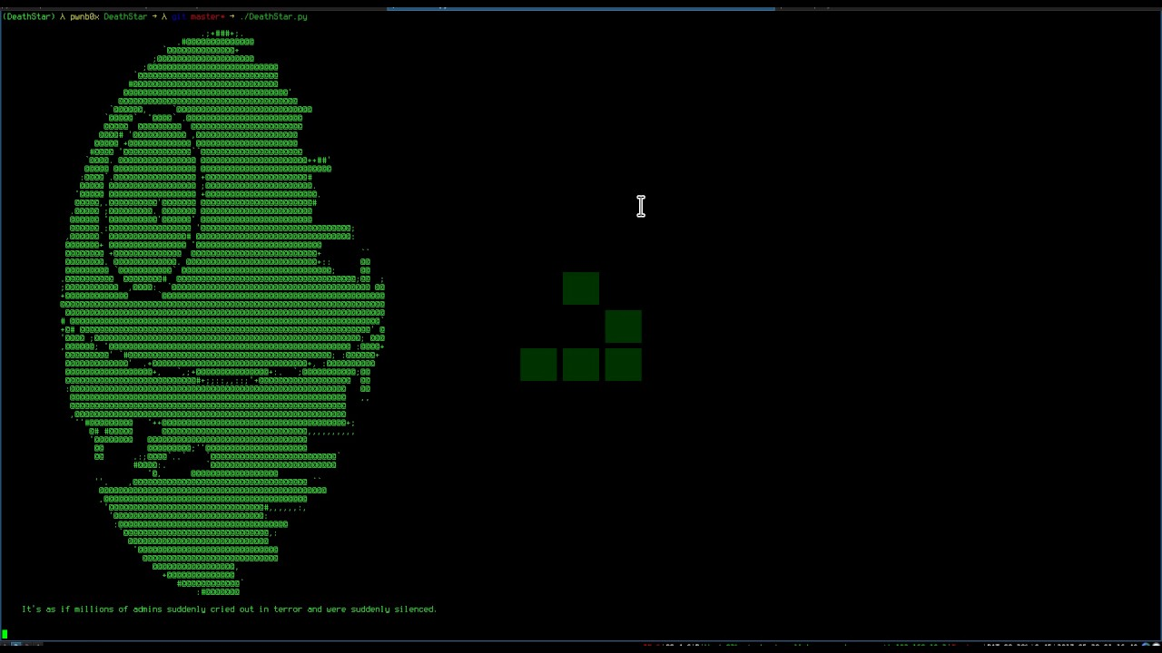
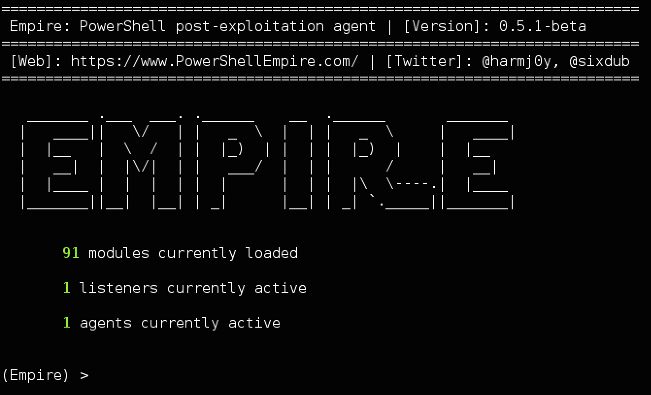
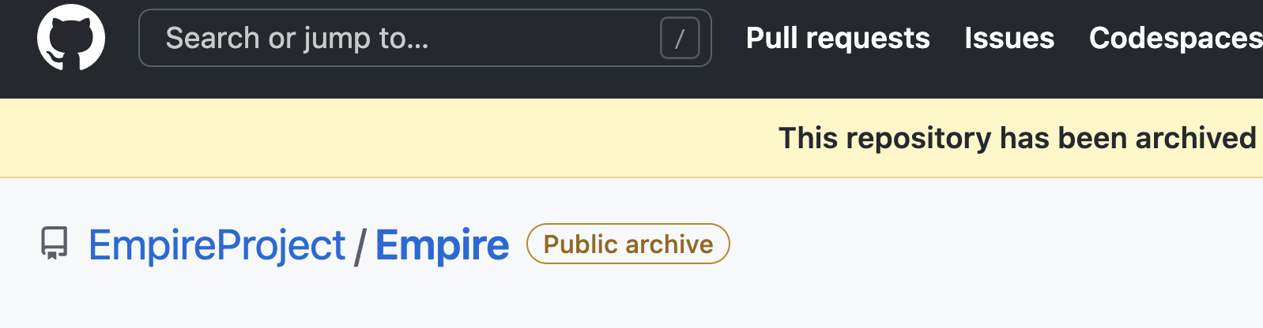
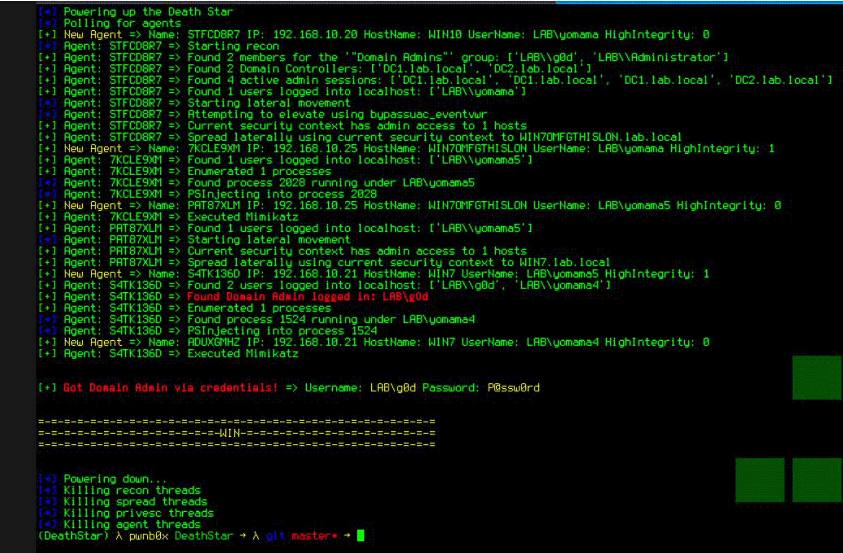
POST
EX
PLOI
TATION
EMPIRE\DEATHSTAR
Notes:
JFC this is hilarious and vicious.
Effectively does the full kill chain we just discussed automagically
Its extremely noisy but. . . . . . that never seems to be an issue :(

Slide 35
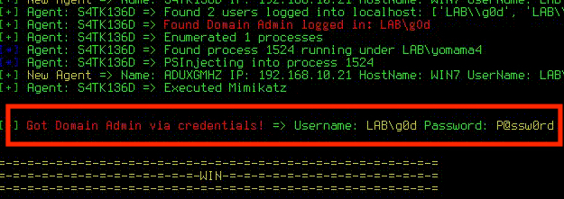
HOORAY!
YOU’RE A DA!
Notes:
OK, but NOW WHAT? (Give examples) (Ransomeware next)

Slide 36
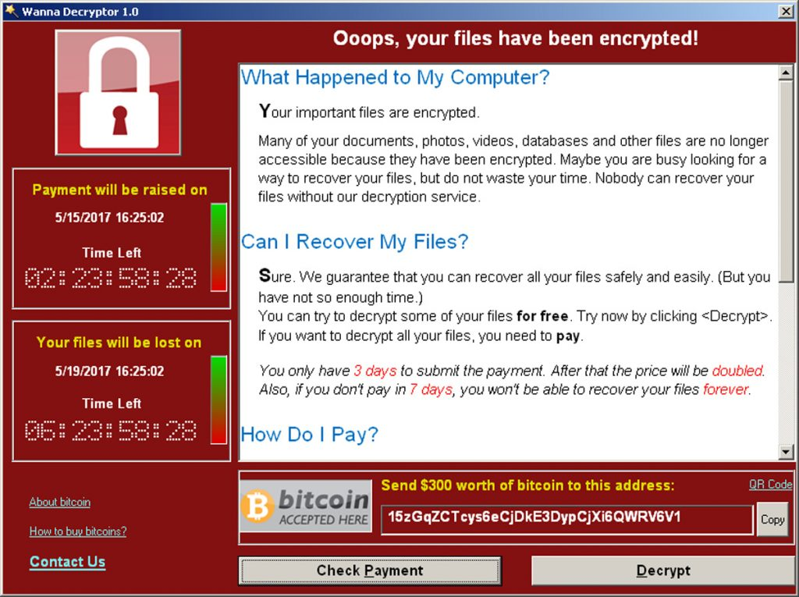
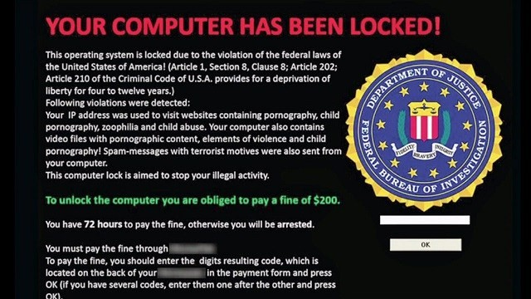
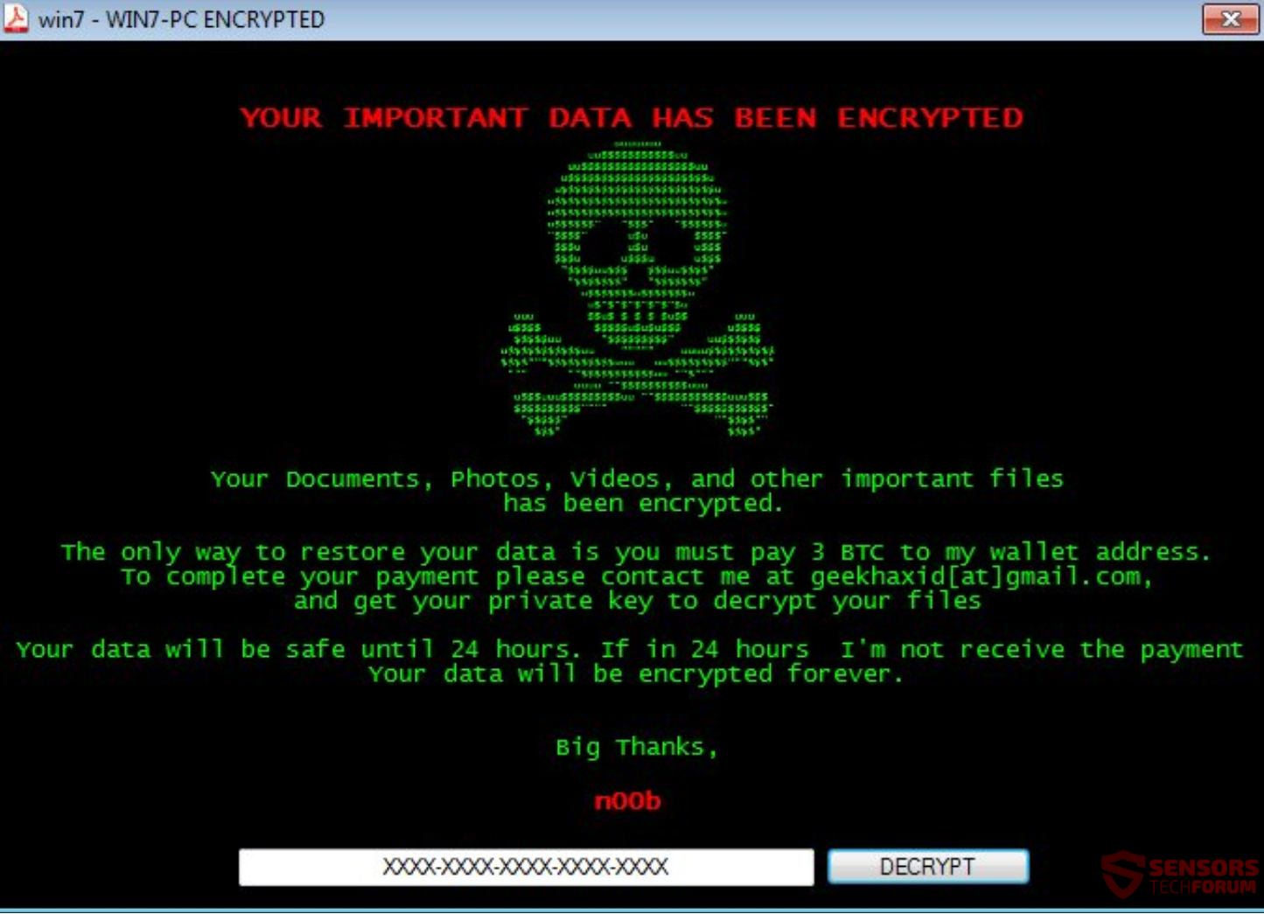
POST
EX
PLOI
TATION
RANSOMWARE
Notes:
At this point (or likely even some precious points) you can absolutely destroy the company with ransomware (RaaS)

Slide 37
POST-EXPLOIT
DEFENSE
// Responder
Disable WPAD, LLMNR, NBT-NS & mDNS
Roll out SMB signing
“Cyber Deception”
// CME
DON’T USE NULL SESSIONS
Alert on mass connections/logins (failed AND successful)
Stop giving everyone and their dog Local Admin privs
Notes:
Also many EDRs can monitor for SMB scanning locally

Slide 38
POST-EXPLOIT
DEFENSE
// Bloodhound
RUN IT FIRST!
Alert on anomalous traffic volume to a single DC (syslog, not EDR)
Set query limit on the DC (DANGER)
// Mimikatz
Most EDR blocks this
Alert on “lsass.dmp” file creation
Stop giving everyone and their dog Local Admin privs
Notes:
Use Bloodhound to locate problems before attackers do
Query limit may break stuff. Printers are a huge culprit (but are getting better)

Slide 39
POST-EXPLOIT
DEFENSE
// Rampant Local Admin
Grow a spine
Admin account should not be the “daily driver”
Use granular rules to only allow certain tasks to “Run as Admin”
Use IAM vaults such as CyberArk to “check out” admin rights
ALERT
Notes:
Use Bloodhound to locate problems before attackers do
Query limit may break stuff. Printers are a huge culprit (but are getting better)

Slide 40
POST-EXPLOIT
DEFENSE
// Kerberoasting
Service Account Inventory
Strong passwords that rotate
Unique passwords
Least privileges
Monitor failed attempts
Sound familiar?

Slide 41
POST-EXPLOIT
DEFENSE
// CPO (Certificate) Attacks
Basically:
AUDIT.
MAKE SURE YOU DID IT RIGHT.

Slide 42
POST-EXPLOIT
DEFENSE
// DA Account Availability
Alert on EVERY DA login
CRIT Alert on DA Account Creation
DA account should not be a “daily driver”
Use IAM vaults such as CyberArk to “check out” admin rights & unlock DA accounts

Slide 43
APPEN
DIX:
TOOLS
OF
NOTE
ScanCannon
Shodan
Hydra
https://github.com/johnnyxmas/ScanCannon
https://www.shodan.io/
https://www.thc.org/thc-hydra/
Evil Foca
Recon-ng
TheHarvester
https://www.elevenpaths.com/labstools/evil-foca/index.html
https://bitbucket.org/LaNMaSteR53/recon-ng
https://github.com/laramies/theHarvester
MailSniper
Burp Suite
FiercePhish
https://github.com/dafthack/MailSniper
https://portswigger.net/burp/freedownload
https://github.com/Raikia/FiercePhish
IkeForce
Metasploit
CrackMapExec
https://github.com/SpiderLabs/ikeforce
https://www.metasploit.com/
https://github.com/byt3bl33d3r/CrackMapExec

Slide 44
APPEN
DIX:
TOOLS
OF
NOTE
(cont.)
Rid_enum
Bloodhound
Mimikatz
https://github.com/trustedsec/ridenum
https://github.com/BloodHoundAD/BloodHound/wiki/Getting-started
https://github.com/gentilkiwi/mimikatz/releases
Powershell Empire
Deathstar
DuoSec (MFA)
https://www.powershellempire.com/
https://github.com/byt3bl33d3r/DeathStar/blob/master/DeathStar.py
https://duo.com/pricing/duo-mfa
SpoofSpotter
CyberArk
Petit Potam PoC
https://github.com/NetSPI/SpoofSpotter
https://www.cyberark.com/
https://threat.tevora.com/petitpotam-the-full-attack-chain-with-windows-and-linux/
Cewl
Responder
https://digi.ninja/projects/cewl.php
https://github.com/lgandx/Responder

Slide 45

FIN
grimm.rip
JOHNNY XMAS
DIRECTOR
@GrimmCyber || GRIMM.RIP
@J0hnnyXm4s
By Johnny Xmas - linktr.ee/johnnyxmas

